Slide 1


2d PlatformER type UNITY GAME
- SunnyLandAssets - Assets to make the game.
Praveen Kumar 20BAI1145
Subhadip Nandi 20BAI1131
Nipun Rautela 20BAI1135

Slide 2
Introduction
The objective of the game is to progress through levels by defeating enemies, collecting items and solving puzzles without dying.
In our 2D platformer game, the player character jumps on platforms and enemies while avoiding their attacks and moving to the right of the scrolling screen.
This 2D game levels have single-exit objectives, which must be reached within a time limit and lead to the next sequential level.

Slide 3
Unity for 2d games
Unity is a cross-platform game engine developed by Unity Technologies
Unity is an extremely popular and versatile game engine that has a long list of supported platforms and devices to its credit.
Unity gives users the ability to create games and experiences in both 2D and 3D, and the engine offers a primary scripting API in C# using Mono, for both the Unity editor in the form of plugins, and games themselves, as well as drag and drop functionality

Slide 4
Current goal
Physics -> gravity, collision
Game mechanics -> idle, run, jump, double jump, crouch, fall
Item interaction -> pick up, examine, inventory, consume
Create a map
Add some audio
Add enemy - AI and patrol
Health bars and lives
Traps
Wall slide and Wall jump
Death and respawn
Dynamic camera

Slide 5
Future Prospects
Dialogue
Moving platforms
Shooting mechanics
Pick up and drop items
Item stacking and inventory status

Slide 6
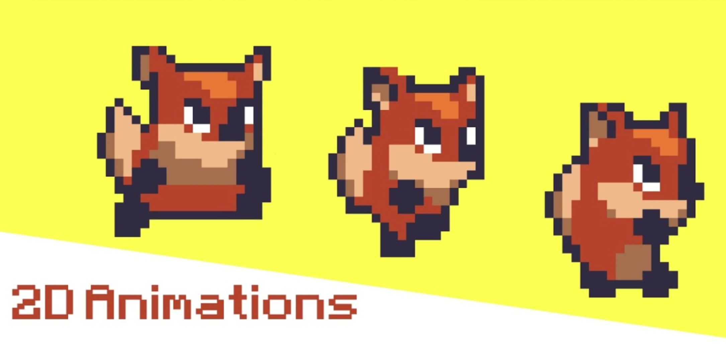
DEMO

Slide 7
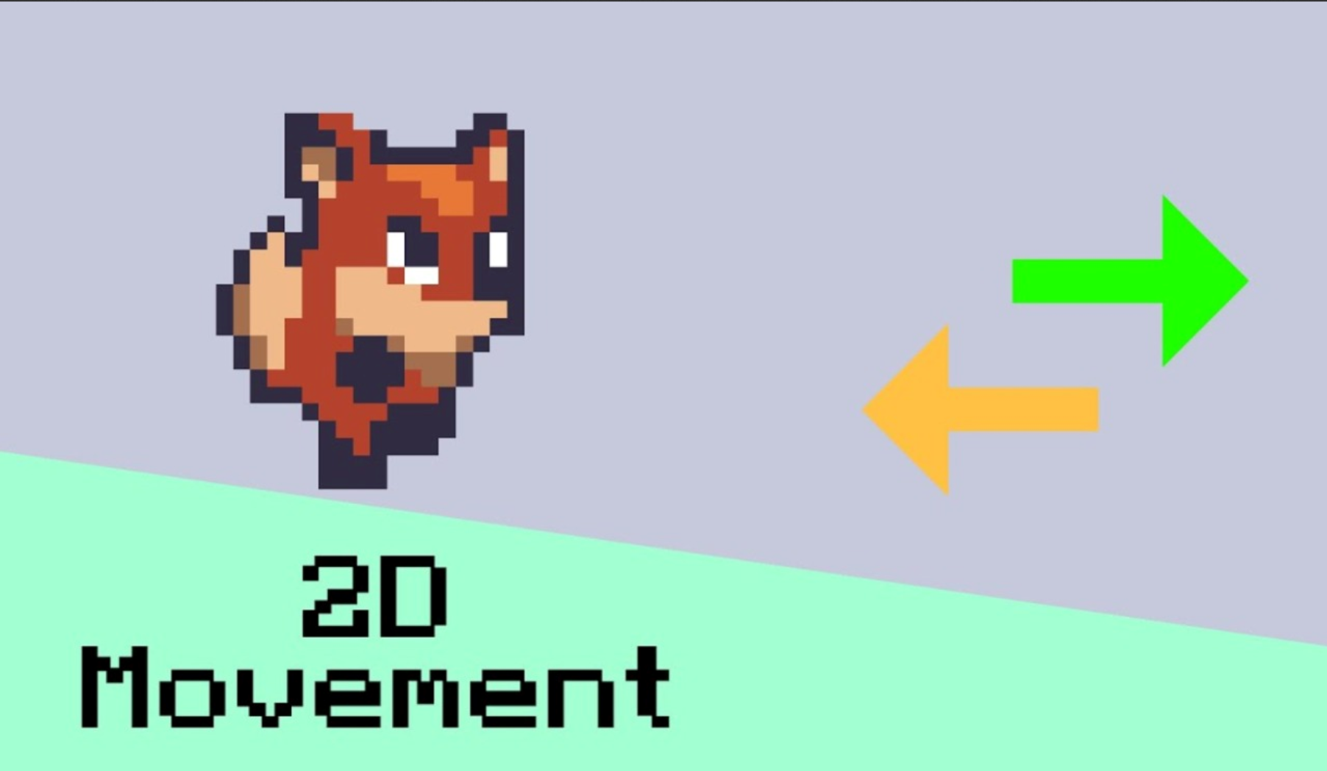

Slide 8


Slide 9
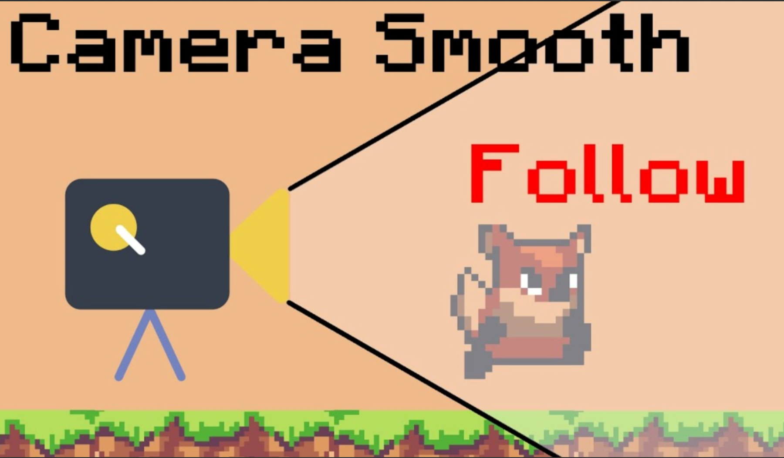

Slide 10


Slide 11
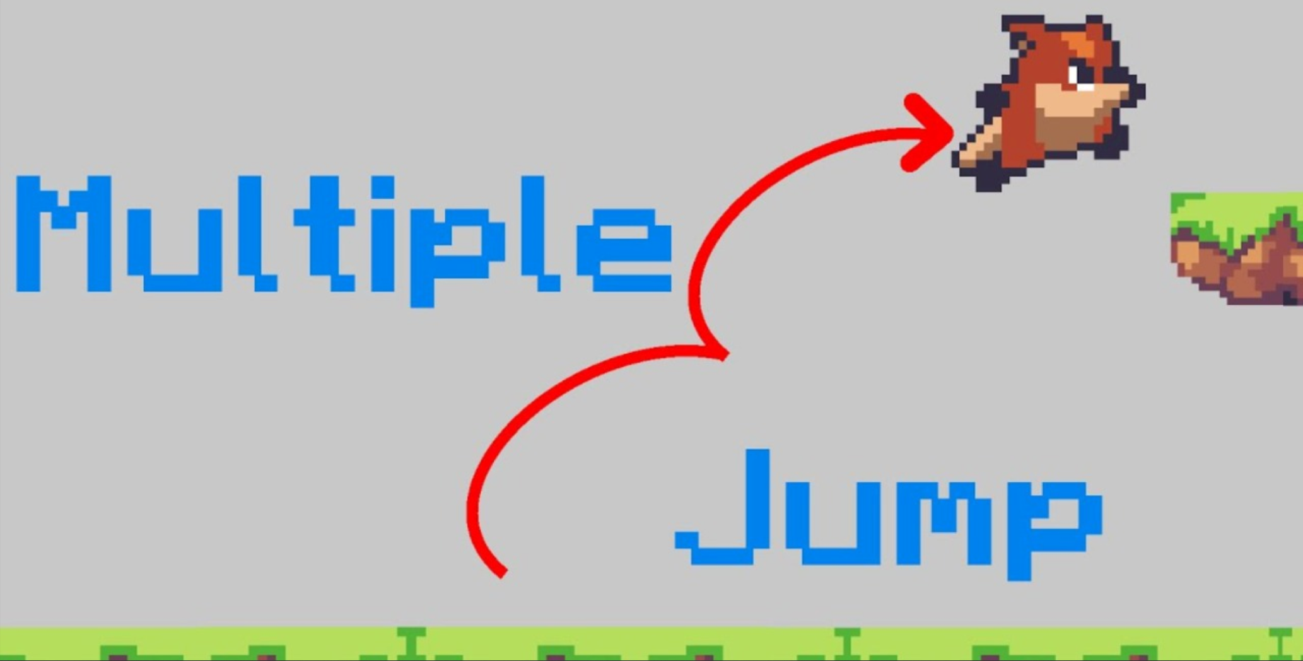

Slide 12
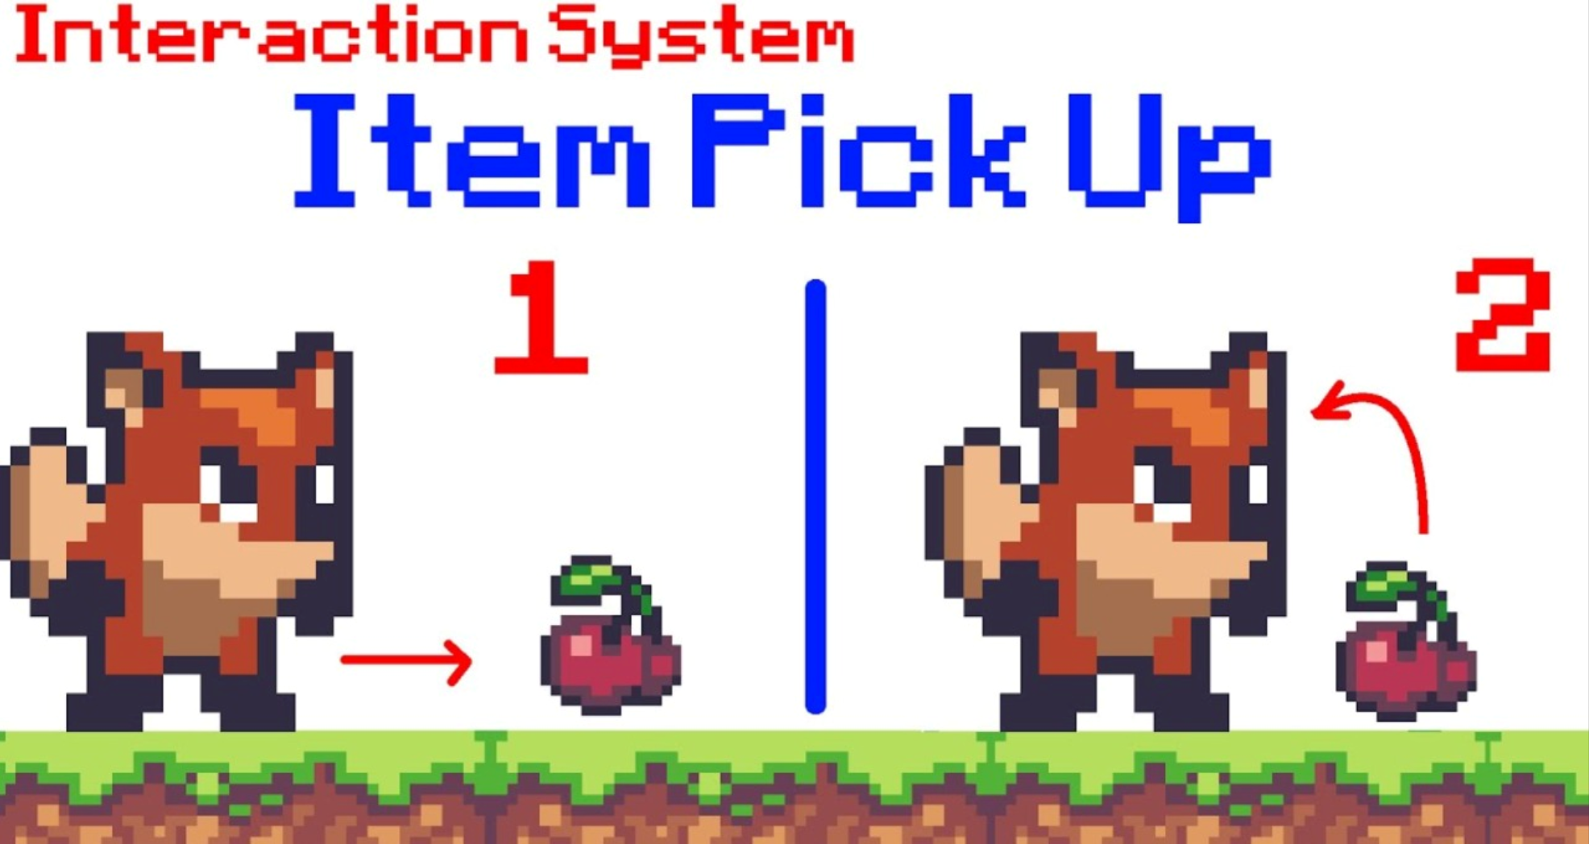

Slide 13
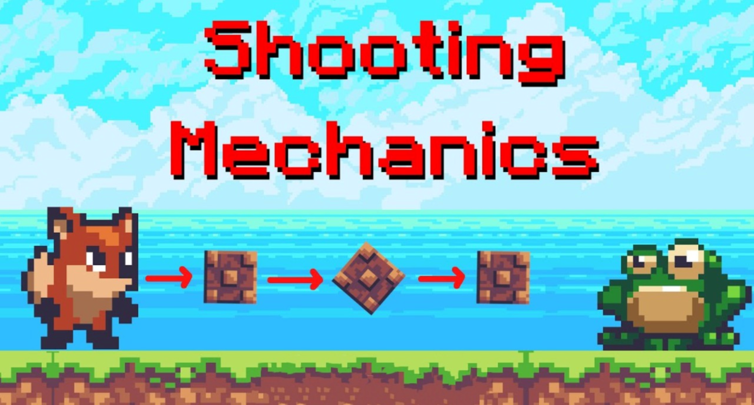

Slide 14
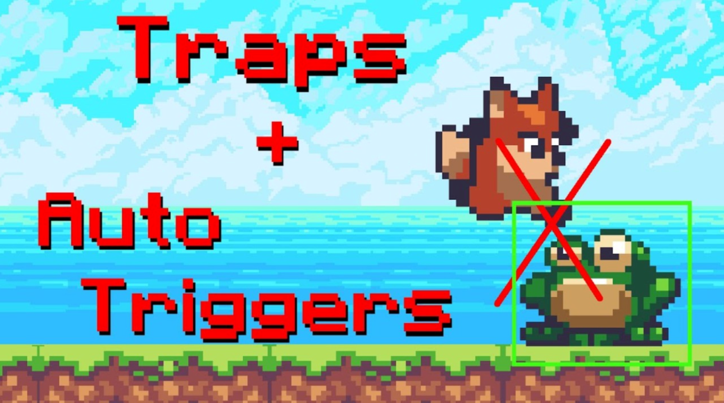

Slide 15


Slide 16
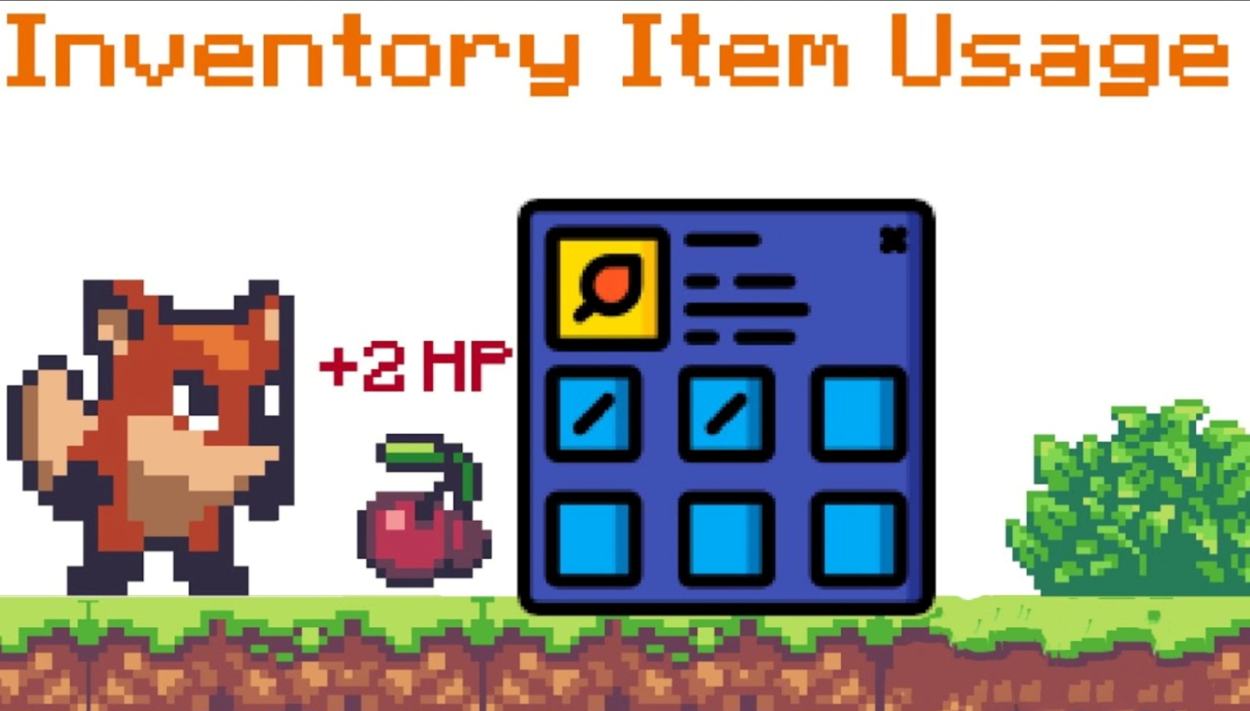

Slide 17


Slide 18
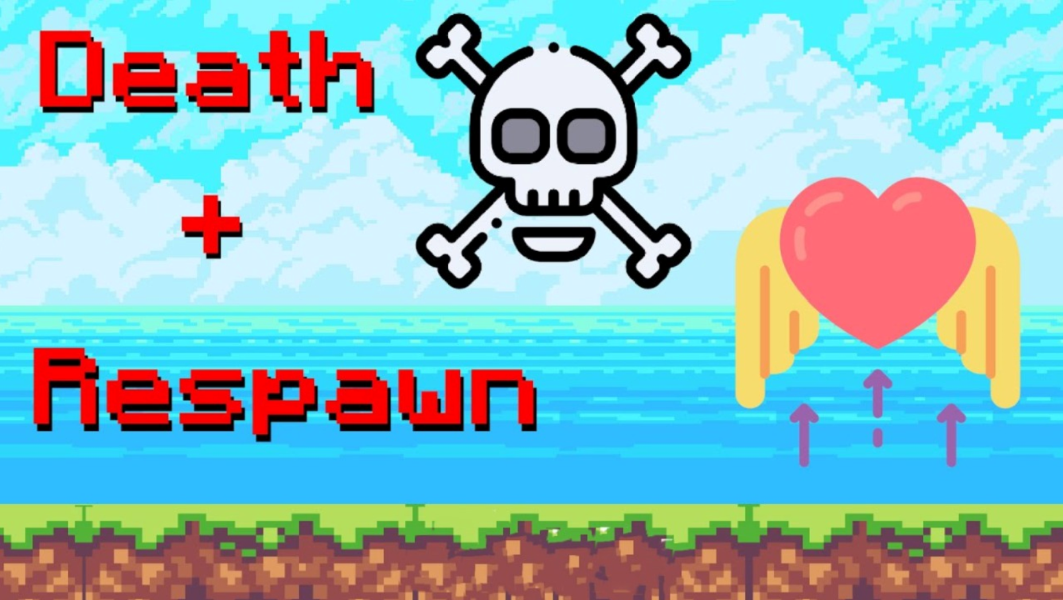

Slide 19
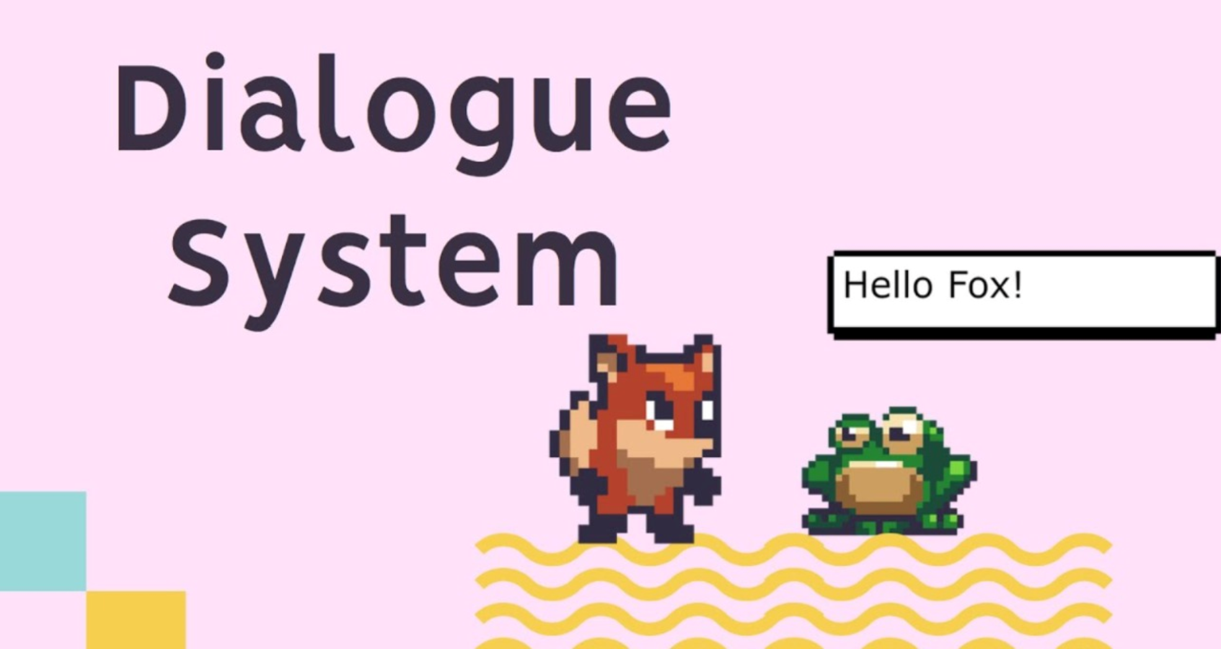

Slide 20
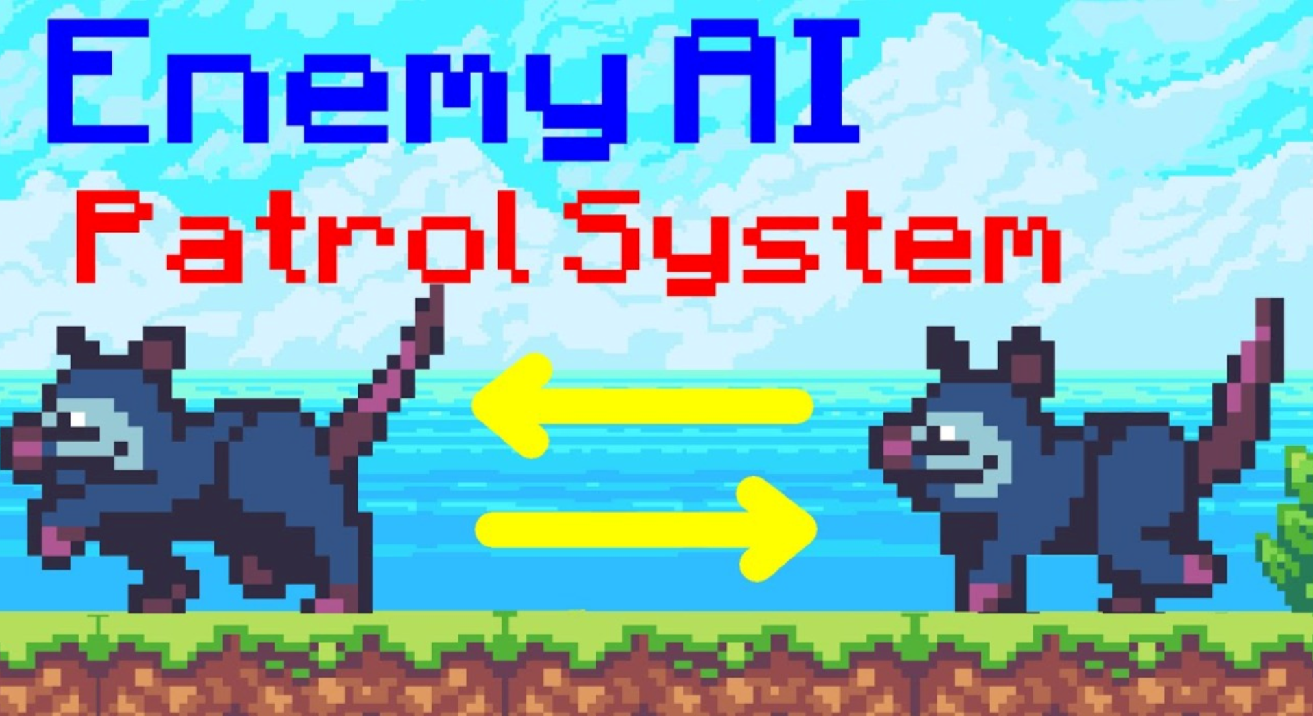

Slide 21
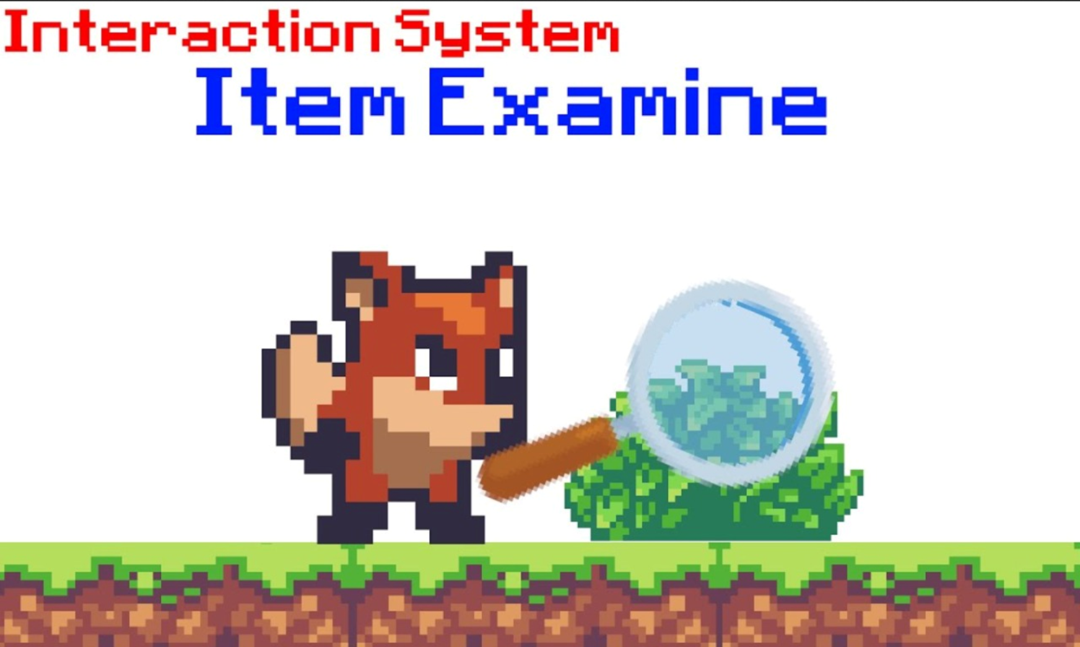

Slide 22


Slide 23
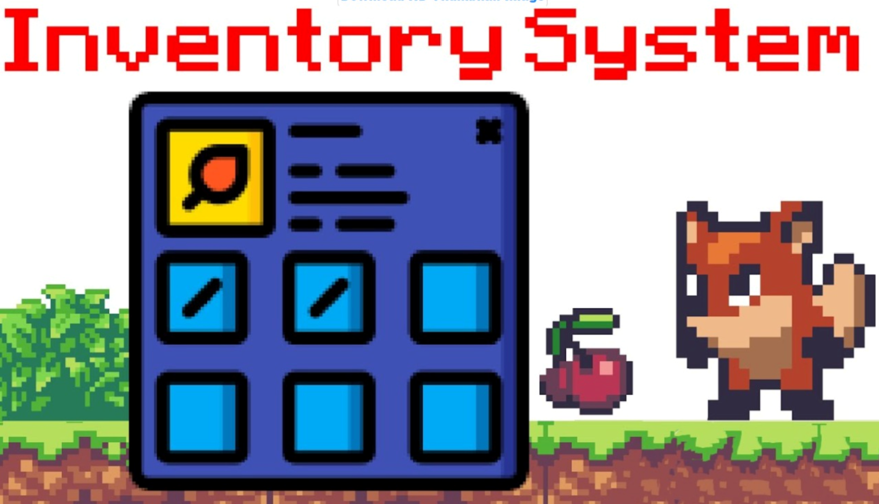

Slide 24
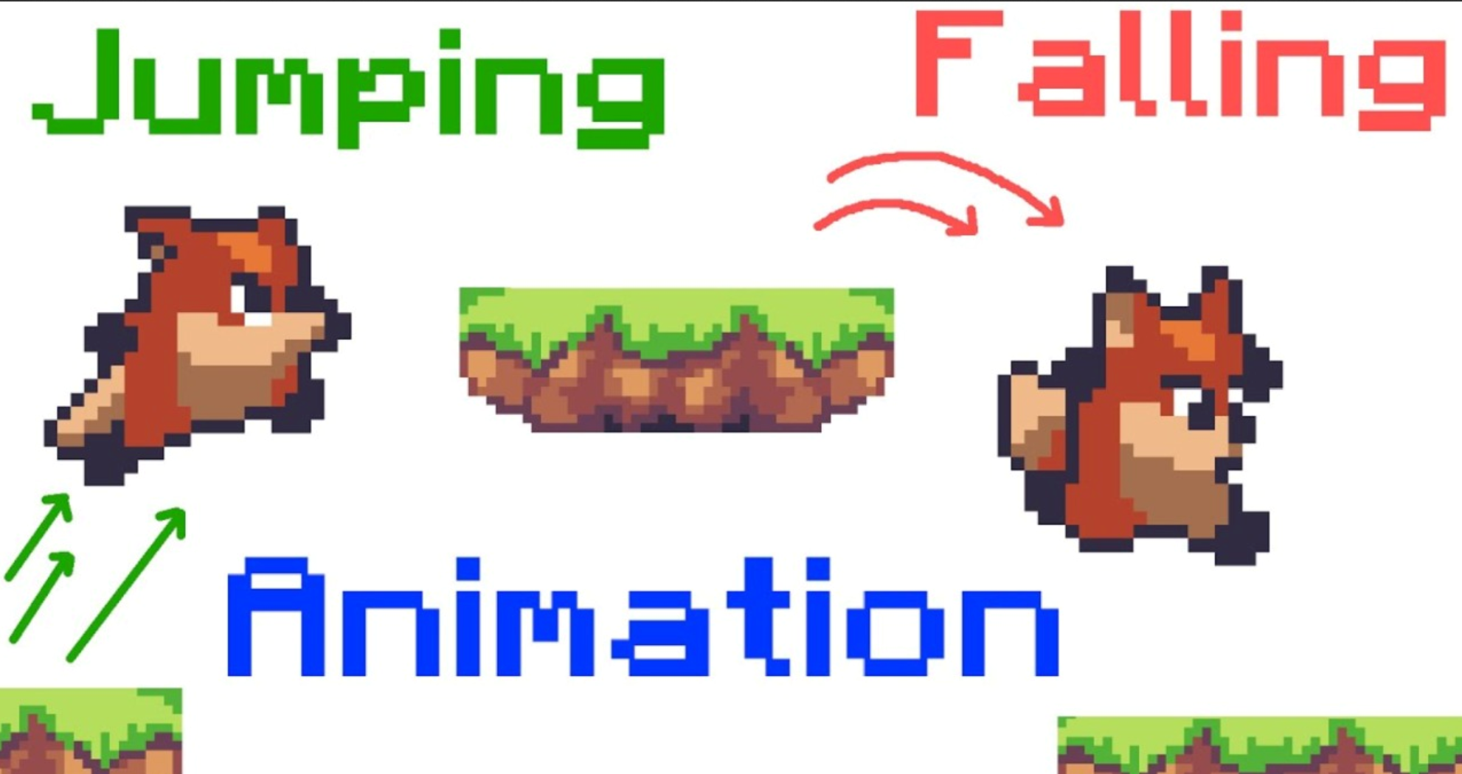

Slide 25
